Slide 1
Guide
When you complete to write this doc, please delete this page.
All green and Italic font(e.g., like this) are for guidance. When you write your own contents, please delete the guide comments.
All required item should be filled. If not, the app testing will be rejected.
If your app has “Quiz” part, please provide ‘answer sheet’. Your app will be tested much easier and faster.

Slide 2
TV BY Persik

Slide 3
Revision History
Version | Date | Description | Author
2.0 | 2017.03.27 | Document created | Pavel Salakhov

Slide 4
Contents
UI Structure
Usage Scenario
Menu & function description
Key policy
How to change languages

Slide 5
UI structure

Slide 6
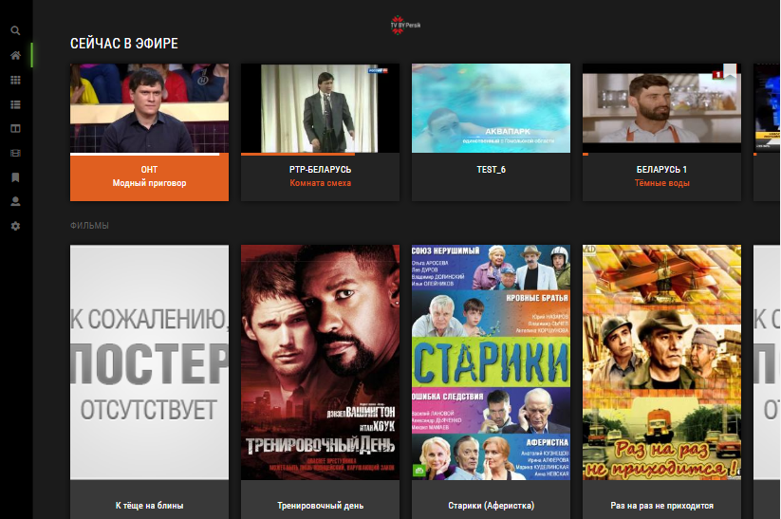
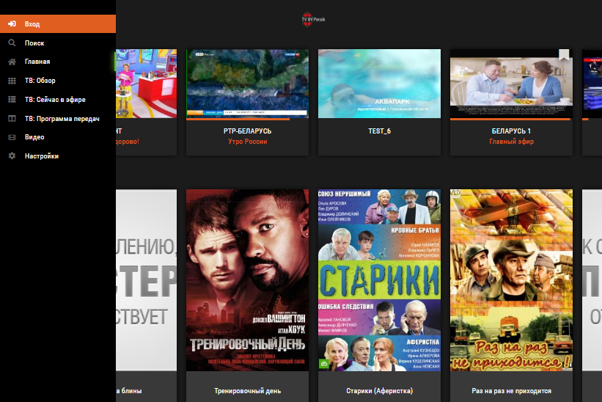
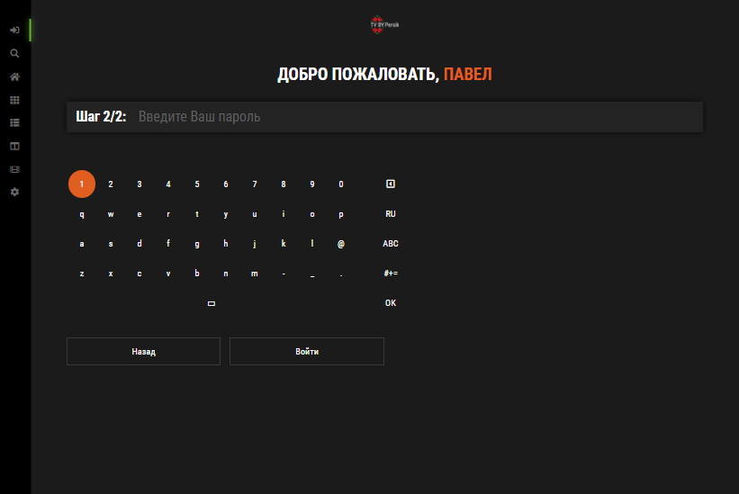
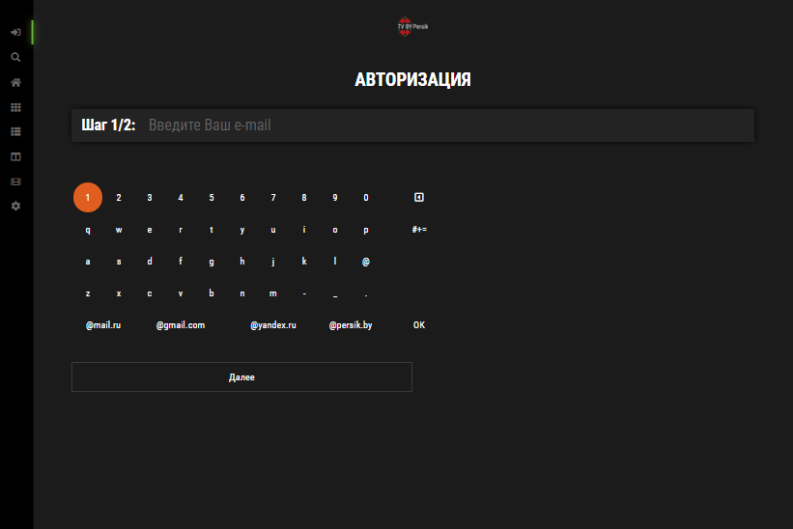
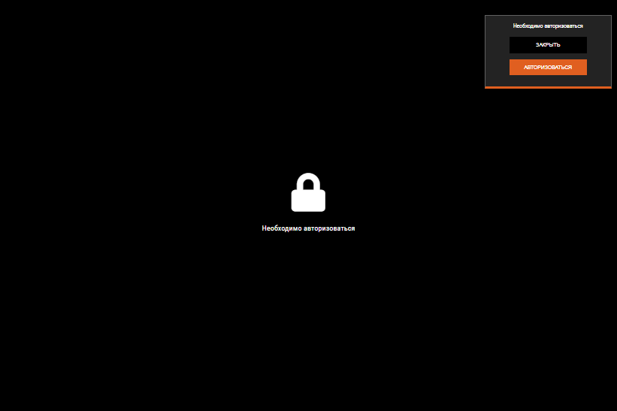
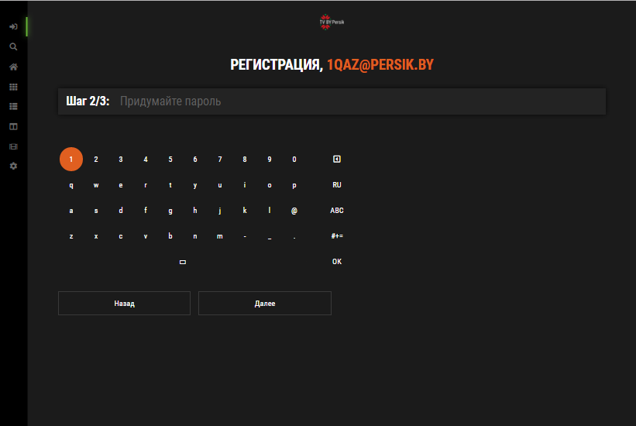
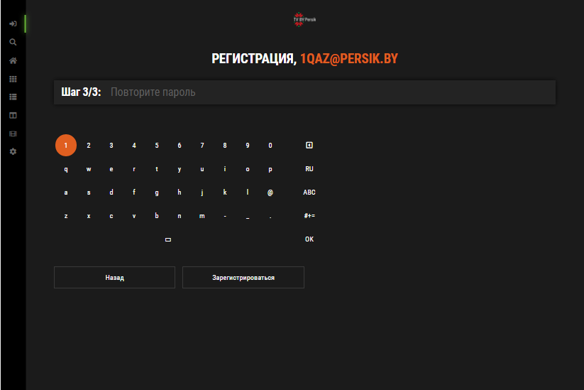

Usage Scenario
Authorization and Registration function
Authorization Requests Screens
Main Screen
(in Main Menu)
Main Screen
(if authorization
successful)
Authorization Screen
Password Request
TV Player
Screen
Authorization Screen
Login Request.
If user is not registered, after entering e-mail, is redirected to the registration page
VOD Player
Screen
Registration Screen
Creating Password
(must be longer or
equal to 6 characters)
Registration Screen
Repeat Password

Slide 7
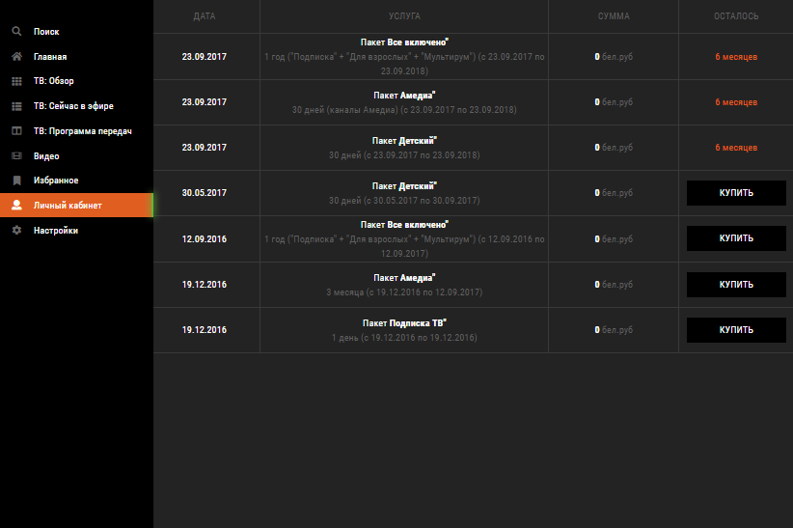
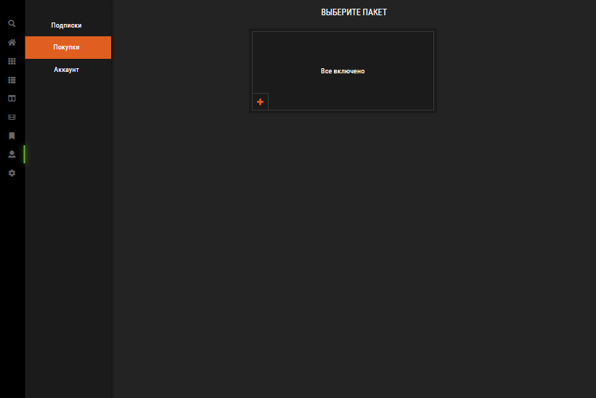
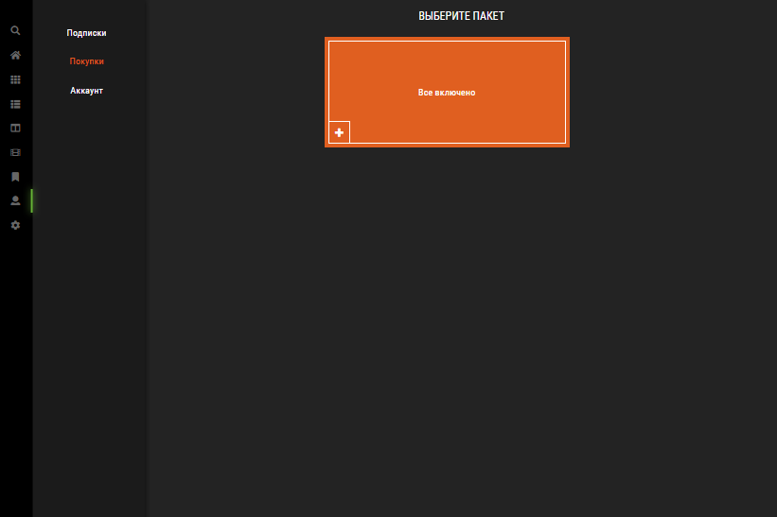
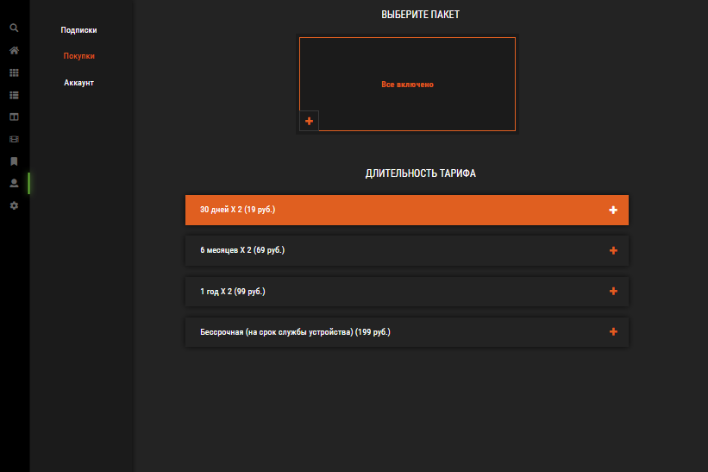
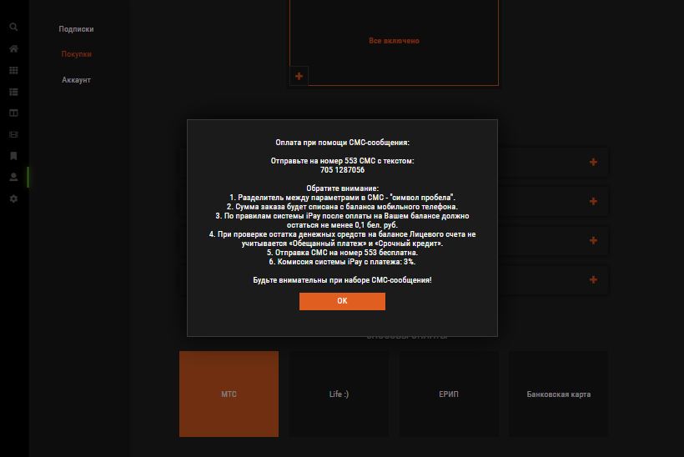
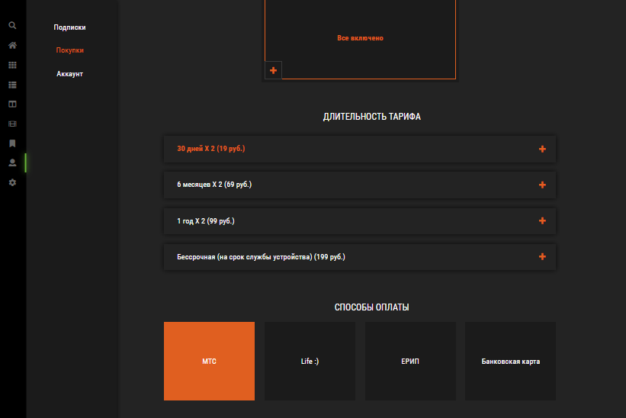
Usage Scenario
In-App Purchases function
Select Personal
Cabinet in the Main
Menu on Any Screen
Select Purchases in the
Personal Cabinet Menu
Select the Required
Package from the List
Select the Required
Time of the Package
from the List
Follow the instructions to complete the
Payment *
Choose the method of payment
* If you choose to pay by credit card, you will be redirected to the payment system web-page.

Slide 8
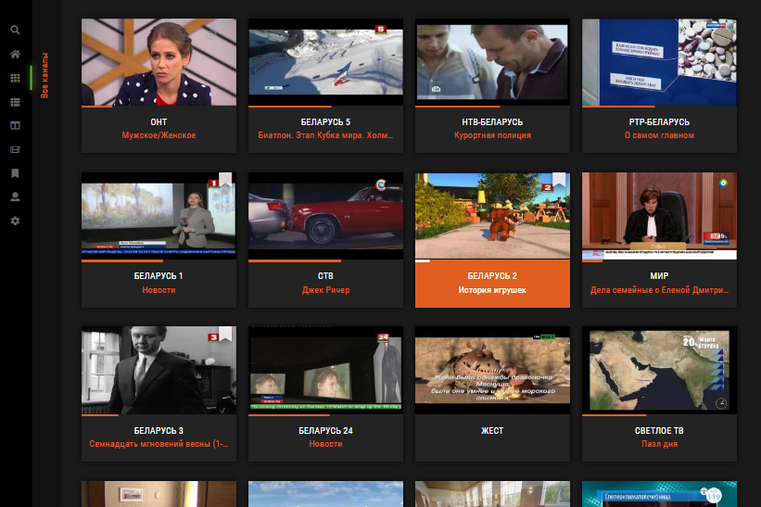
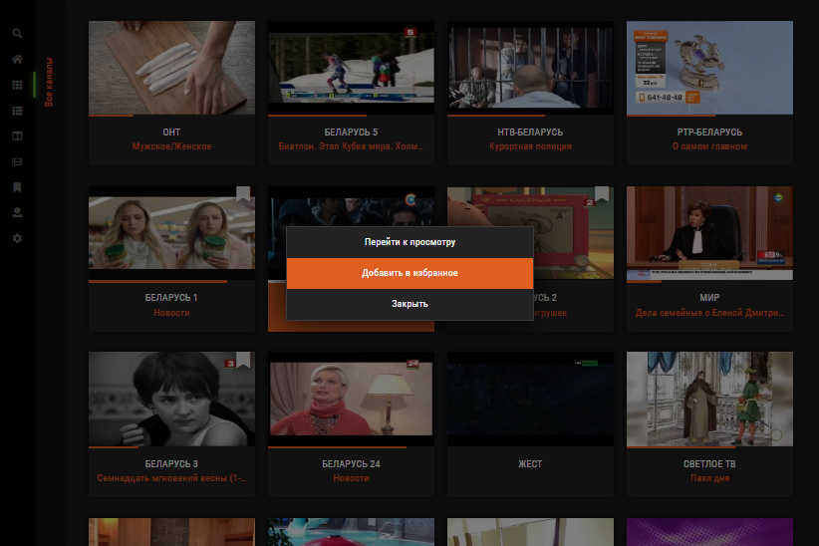
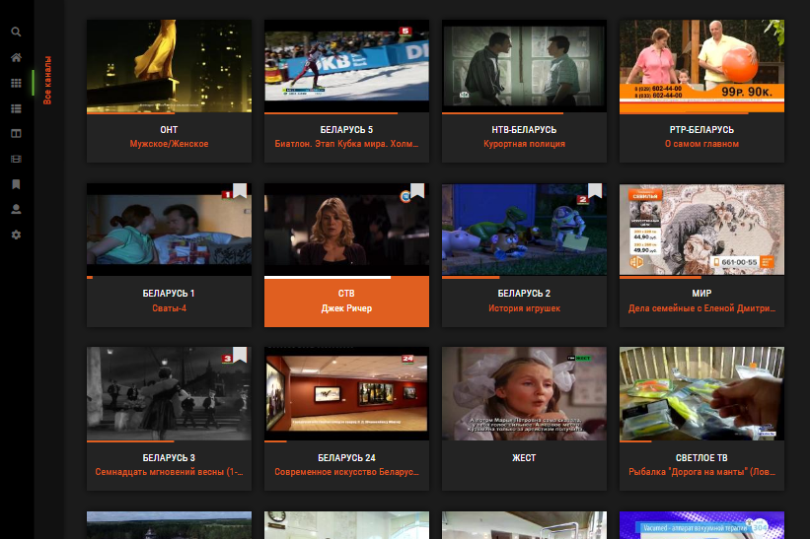
Usage Scenario
Adding a TV Channel to Favorites from the Main Screen or the "TV: Overview" Screen
Select
"Add to Favorites"
Select the Desired
TV Channel
Press and Hold the
“OK” Button on Remote
Until the Menu Appears
If Everything is, a
Mark will Appear on
the TV Channel Box

Slide 9
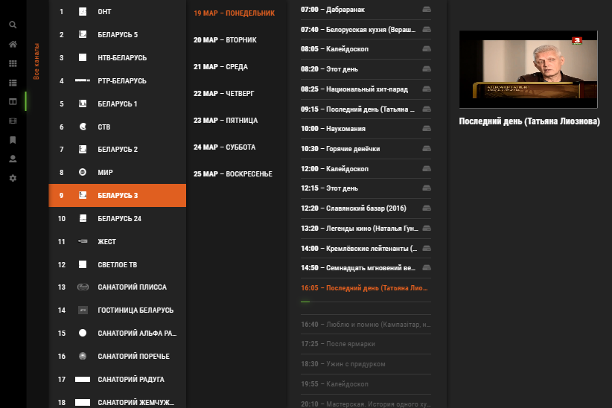
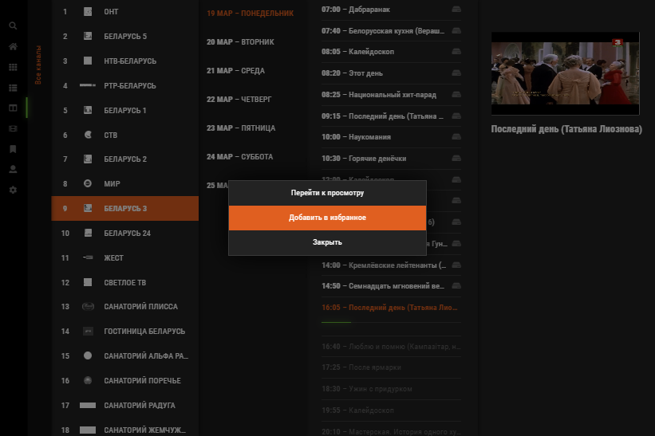
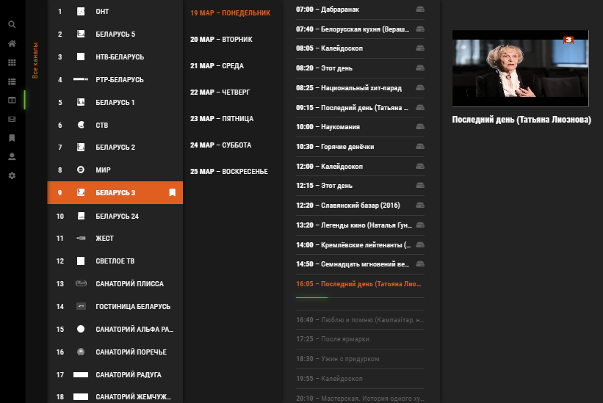
Usage Scenario
Adding a TV Channel to Favorites from the "TV: Program Guide" Screen
Select
"Add to Favorites"
Select the Desired
TV Channel
Press and Hold the
“OK” Button on Remote
Until the Menu Appears
If Everything is, a
Mark will Appear on
the TV Channel Box

Slide 10
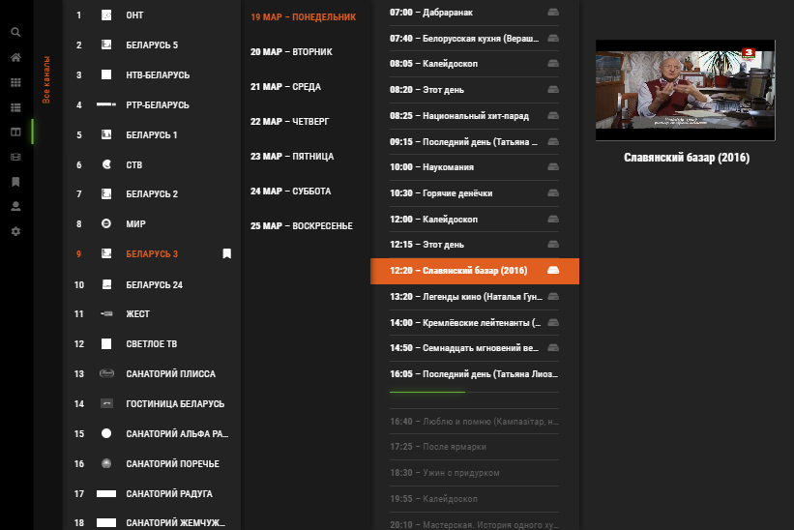
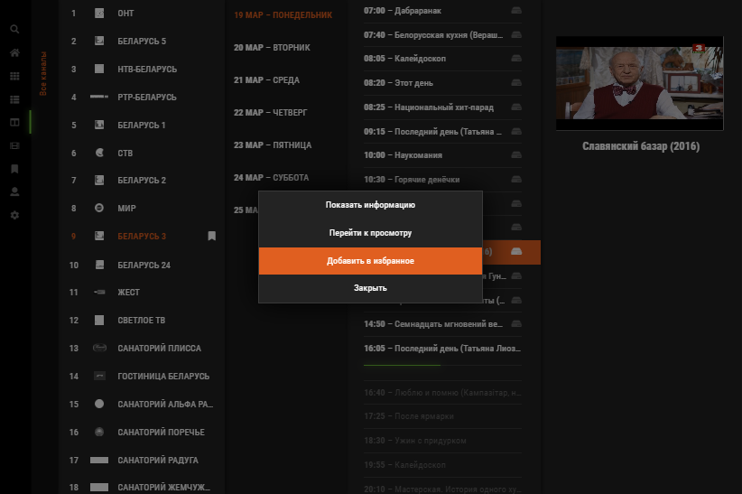
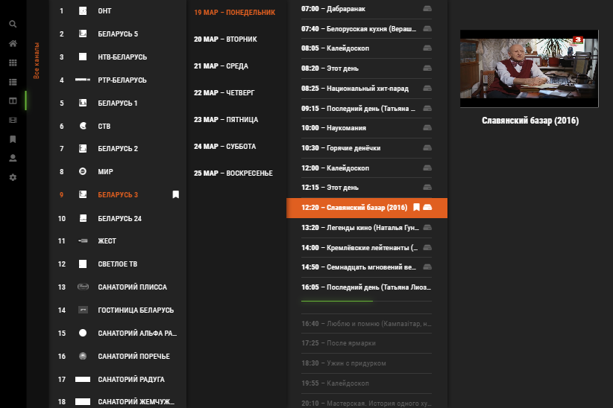
Usage Scenario
Adding a TV Show or Movie to Favorites from the "TV: Program Guide" screen
Select
"Add to Favorites"
Select the Desired
TV Show or Movie *
Press and Hold the
“OK” Button on Remote
Until the Menu Appears
If Everything is, a Mark
will Appear on the
TV Show or Movie Box **
* You can choose any TV show or movie in the guide for the future or the past
** The TV show or movie is saved in the favorites until they are deleted by the user or the archiving time expires

Slide 11
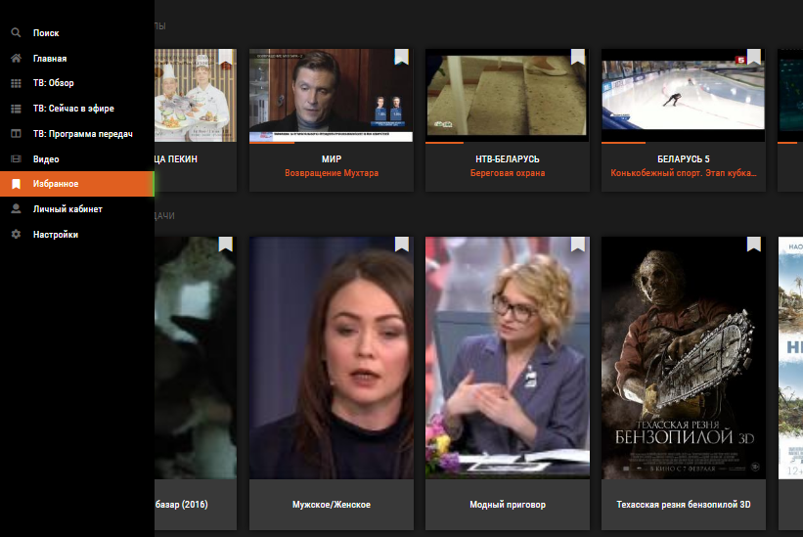
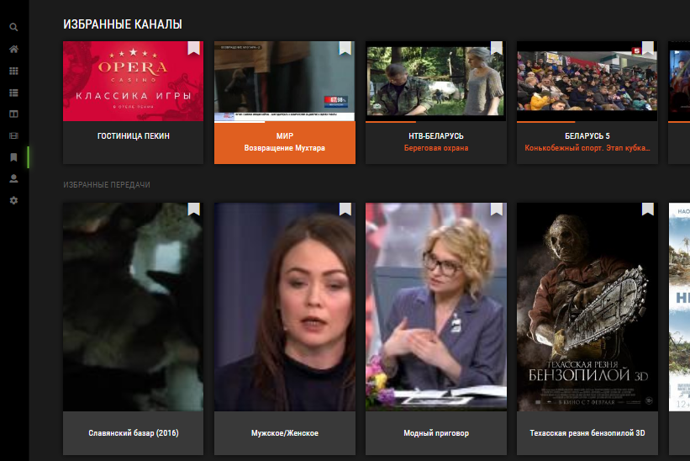
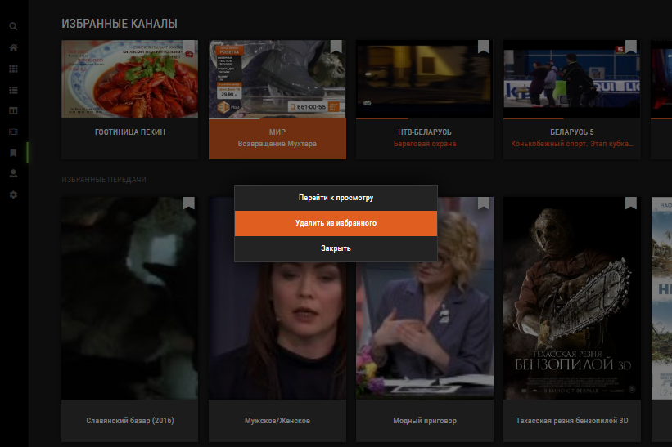
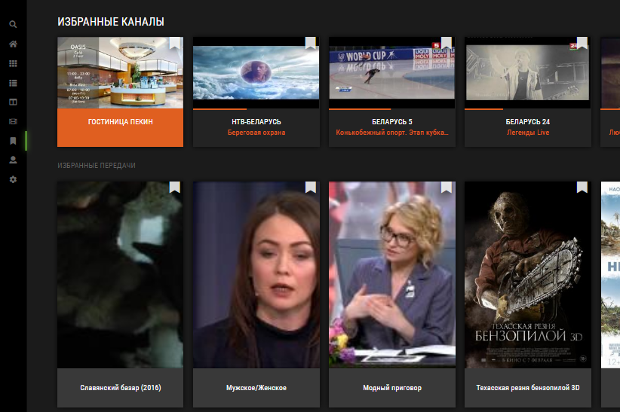
Usage Scenario
Deleting any items from favorites
Select
“Remove from
Favorites"
Select Favorites in the Main Menu on
Any Screen
Select the Desired
Item
Press and Hold the
“OK” Button on Remote
Until the Menu Appears
If Everything is, a Mark
will Appear on the
TV Show or Movie Box **

Slide 12
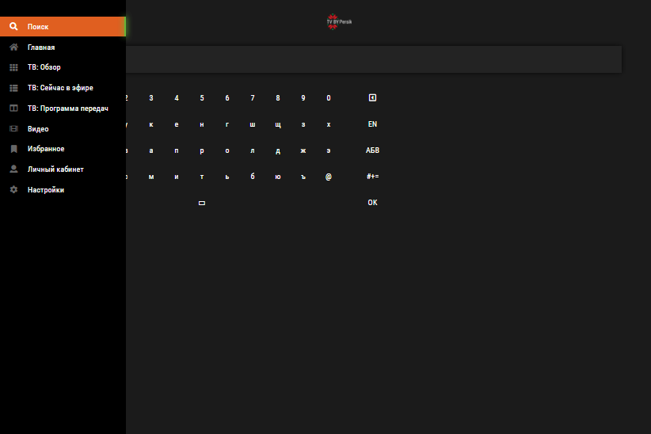
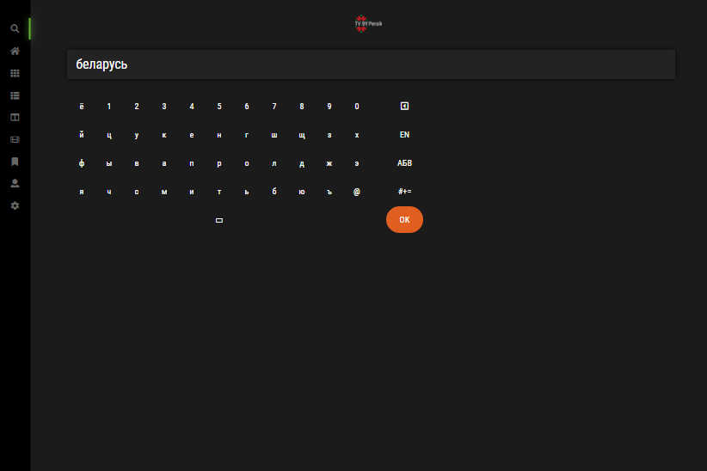
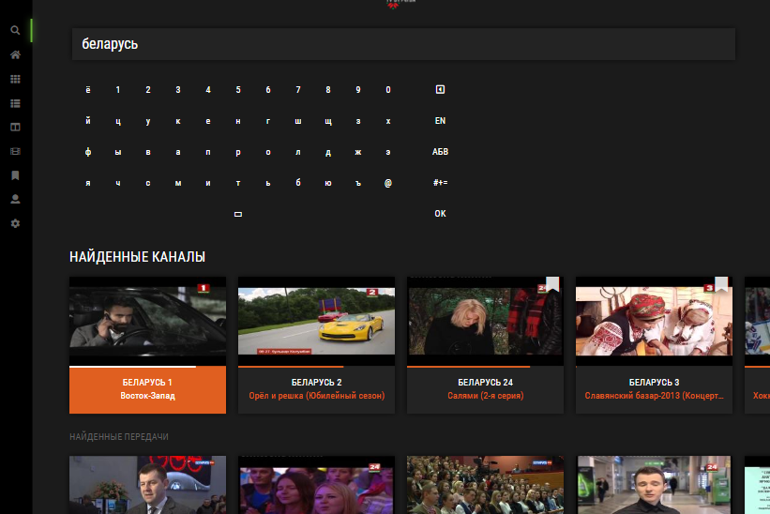
Usage Scenario
Search Items
Select «Search» in the Main Menu on
Any Screen
Type the Search Word
on the Virtual
Keyboard and click OK
In the List that Appears
Below, Select the Item You
are Looking for

Slide 13
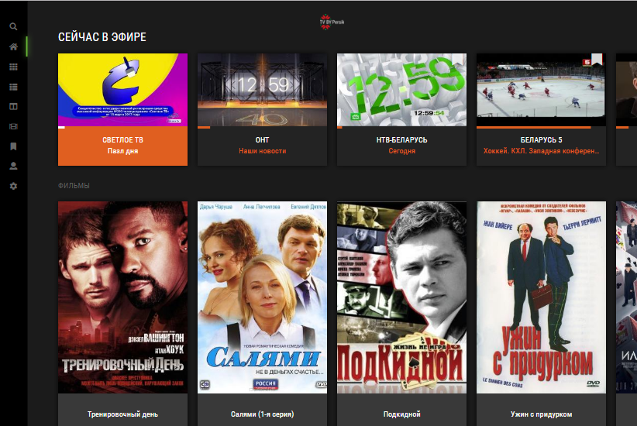
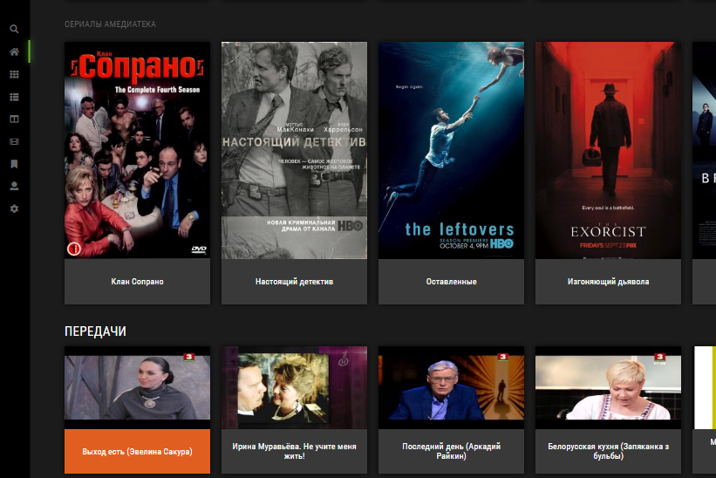
Menu & function description
Main Screen (Главная)
❶
❷
№ | Element | Attribute
1 | Main Menu | It opens when you on the remote control press the "Return" button or the left button, if the leftmost item is selected in the list (The list of menu items may vary depending on whether the user is authorized or not)
2 | Popular TV Channels | 10 popular TV channels selected from the general list
3 | Popular Movies | 10 popular movies selected from the general list
4 | Popular AMEDIATEKA Movies | 10 popular “AMEDIATEKA” movies selected from the general list (to see, flip the screen below)
5 | Popular TV Shows | 10 popular TV shows selected from the general list (to see, flip the screen below)
❸
❹
❺

Slide 14
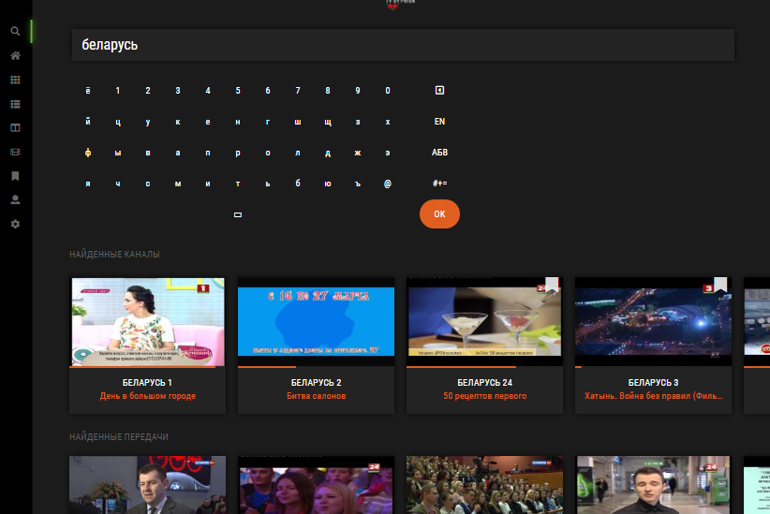
Menu & function description
Search (Поиск) (if user authorized)
❶
№ | Element | Attribute
1 | Main Menu | It opens when you on the remote control press the "Return" button or the left button, if the leftmost item is selected in the list (The list of menu items may vary depending on whether the user is authorized or not)
2 | Search World Field
3 | Virtual Keyboard
4 | Search Results | List of Search Results, grouped by type (TV channels, Movies, TV Shows)
❷
❸
❹

Slide 15
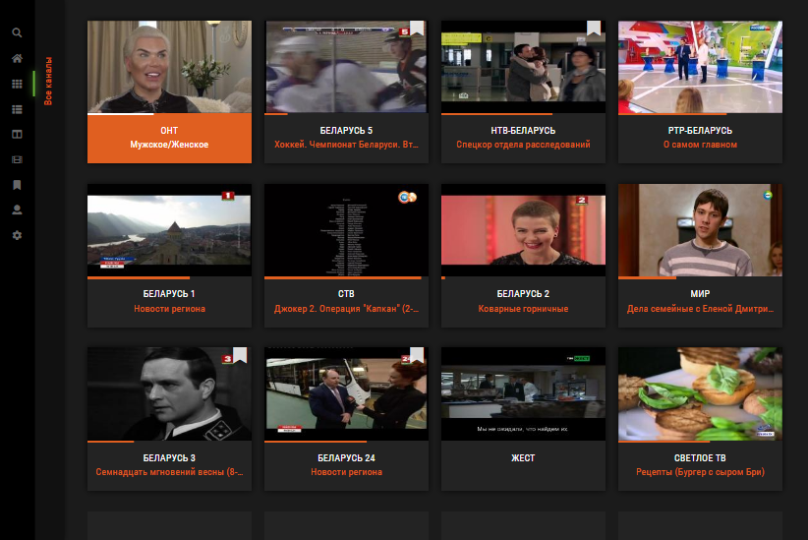
Menu & function description
TV Channels List: Tail (ТВ: Обзор)
❶
❷
№ | Element | Attribute
1 | Main Menu | It opens when you on the remote control press the "RETURN" button or the "Left" button, if any item of the list of genres is selected (The list of menu items may vary depending on whether the user is authorized or not)
2 | Genres filter list | It opens when you press the "Left" button on the remote control if the leftmost item in the list is selected, or the "Right" button if the Main Menu is selected
3 | TV Channels List
❸

Slide 16
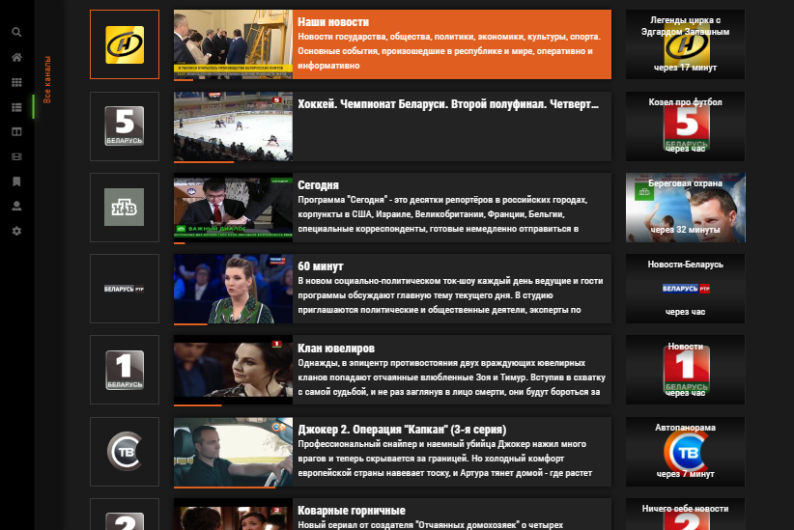
Menu & function description
TV Channels List: List (ТВ: Сейчас в эфире)
❶
❷
№ | Element | Attribute
1 | Main Menu | It opens when you on the remote control press the "RETURN" button or the "Left" button, if any item of the list of genres is selected (The list of menu items may vary depending on whether the user is authorized or not)
2 | Genres filter list | It opens when you press the "Left" button on the remote control if the leftmost item in the list is selected, or the "Right" button if the Main Menu is selected
3 | TV Channels List | Now on air
4 | TV Channels List | Further on the air
❸
❹

Slide 17
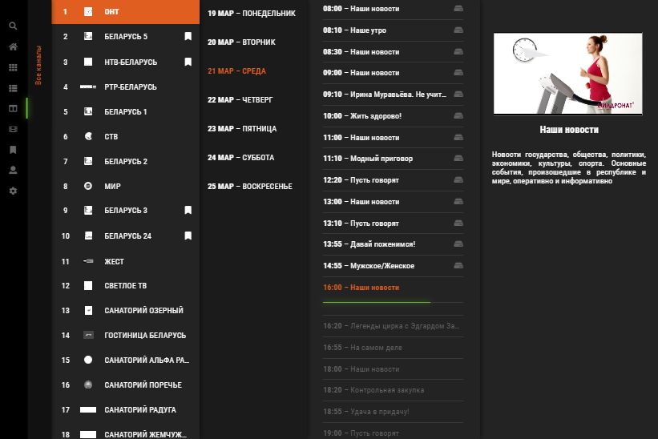
Menu & function description
TV Channels List: List (ТВ: Сейчас в эфире)
❶
❷
❸
❹
❺
❻
№ | Element | Attribute
1 | Main Menu | It opens when you on the remote control press the "RETURN" button or the "Left" button, if any item of the list of genres is selected (The list of menu items may vary depending on whether the user is authorized or not)
2 | Genres filter list | It opens when you press the "Left" button on the remote control if the leftmost item in the list is selected, or the "Right" button if the Main Menu is selected
3 | TV Channels List
4 | List of days
5 | TV schedule for the day
6 | Preview and Description of the selected TV channel

Slide 18
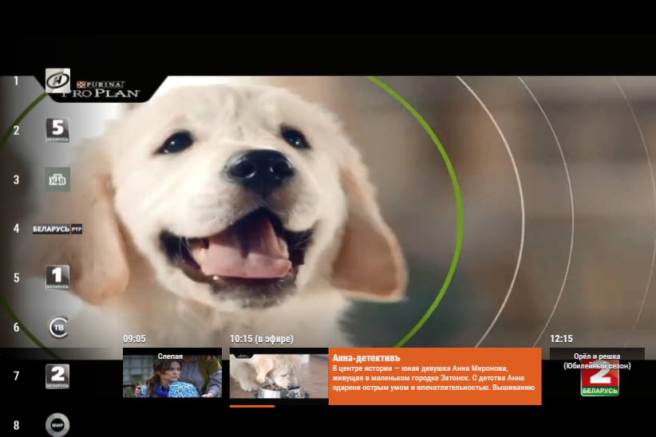
Menu & function description
TV Channel Player
❶
№ | Element | Attribute
1 | TV Player
2 | TV Channels List | To switch TV channels, use the up and down buttons on the remote Control (If you do not do anything, it will be hidden from the screen)
3 | TV Channel Guide | To navigate, use the left and right buttons on the remote control (If you do not do anything, it will be hidden from the screen)
❷
* To return to the previous screen, use the
“RETURN" button on the remote control
❸

Slide 19
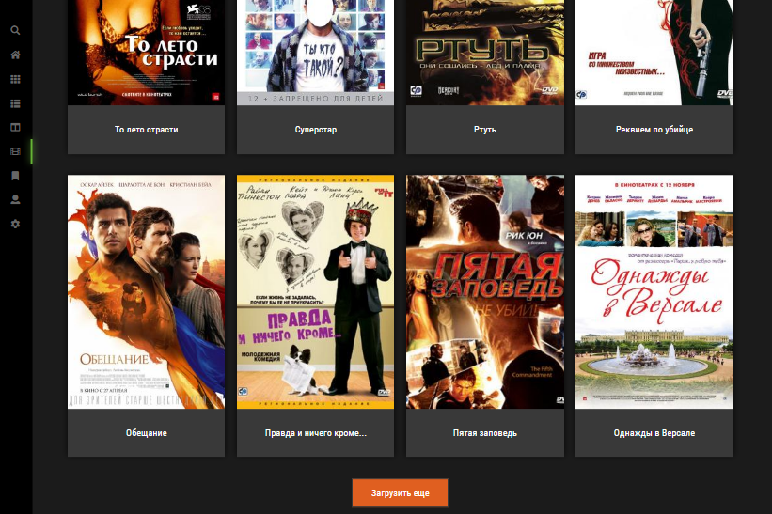
Menu & function description
VOD List (Видео)
❶
❷
№ | Element | Attribute
1 | Main Menu | It opens when you on the remote control press the "Return" button or the left button, if the leftmost item is selected in the list (The list of menu items may vary depending on whether the user is authorized or not)
2 | VOD List
3 | Load More Button
❸

Slide 20
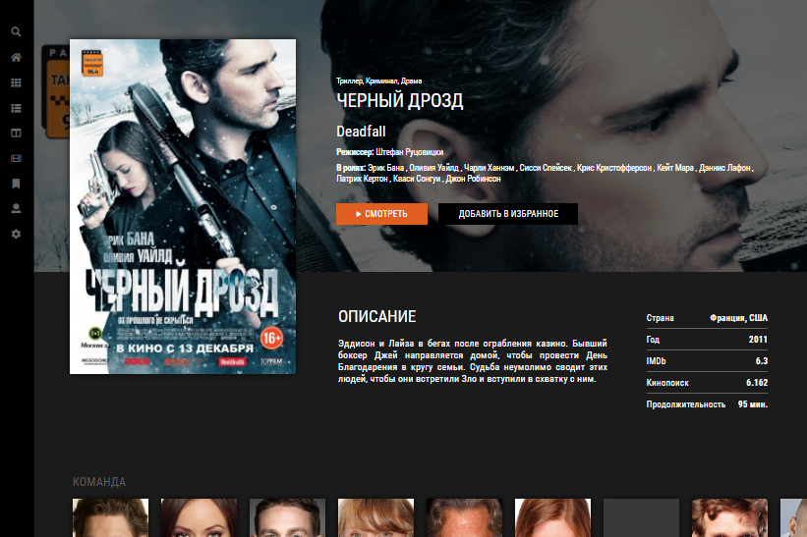
Menu & function description
VOD Info
❶
№ | Element | Attribute
1 | Main Menu | It opens when you on the remote control press the "Return" button or the left button From “Play” Button (The list of menu items may vary depending on whether the user is authorized or not)
2 | VOD Poster
3 | VOD Title
4 | “Play” Button | Opens the VOD player
5 | Add/Remove to Favorites Button | Add or remove the selected VOD to your favorites
6 | VOD Description
7 | The team of the selected VOD creators | Contains their names and photos
❷
❸
❹
❺
❻
❼

Slide 21
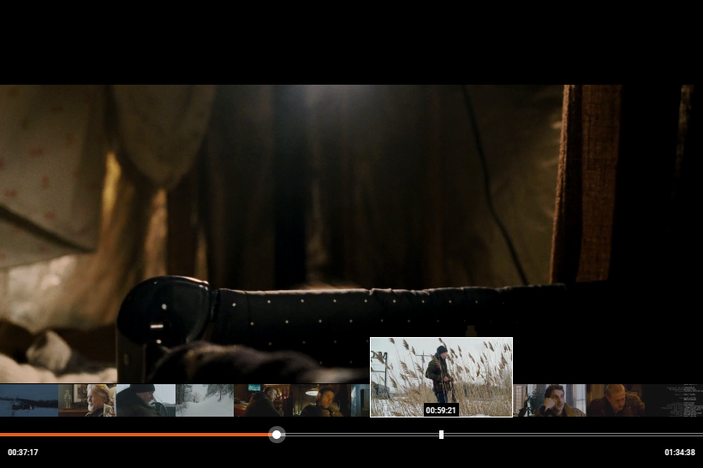
Menu & function description
VOD Player
❶
№ | Element | Attribute
1 | VOD Player
2 | VOD TimeLine Previews | Displays frames of the selected VOD on the whole continuation. At the point where the cursor is located the frame is enlarged (If you do not do anything, it will be hidden from the screen)
3 | VOD TimeLine | Displays the playback progress of VOD (If you do not do anything, it will be hidden from the screen)
4 | VOD TimeLine Cursor | Allows you to navigate between video moments. Use the buttons on the remote control “Left" and “Right" to navigate and "OK" to move to the selected moment
❷
❸
❹
* To return to the previous screen, use the
“RETURN" button on the remote control

Slide 22
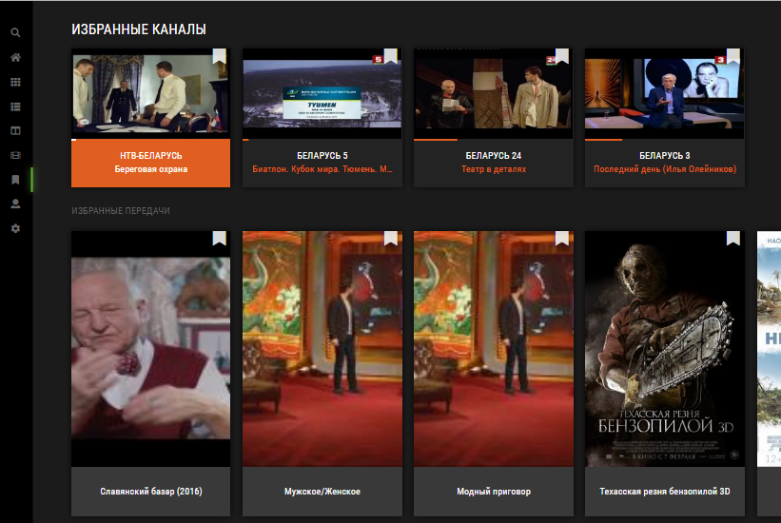
Menu & function description
Favorites (Избранное)
❶
❷
№ | Element | Attribute
1 | Main Menu | It opens when you on the remote control press the "Return" button or the left button, if the leftmost item is selected in the list (The list of menu items may vary depending on whether the user is authorized or not)
2 | Favorites List

Slide 23
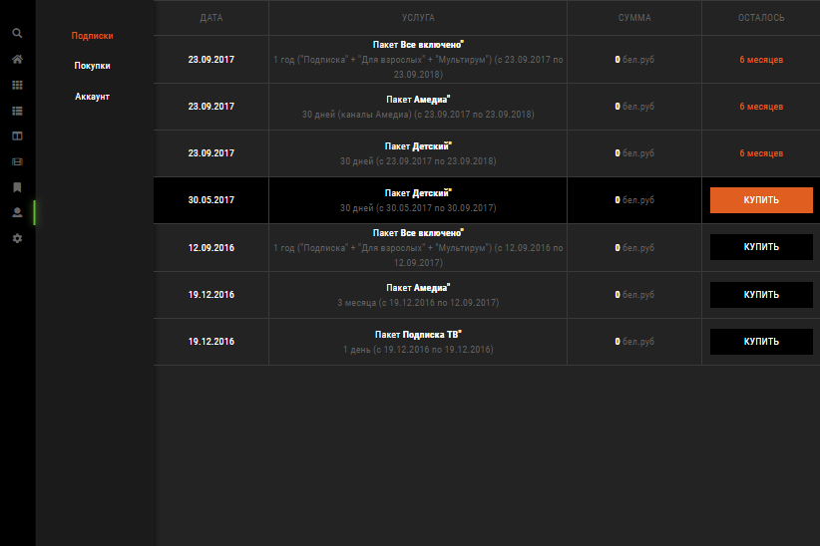
Menu & function description
User`s Cabinet > User`s Subscriptions (Подписки)
№ | Element | Attribute
1 | Main Menu | It opens when you on the remote control press the "Return" button or the "Left" button, if any item of the “User`s Cabinet” menu is selected (The list of menu items may vary depending on whether the user is authorized or not)
2 | User`s Cabinet Menu | Activated immediately after entering User`s Cabinet or by pressing the button on the remote to the “Left” if the cursor is in the List of Subscriptions
3 | List of Subscriptions | To move the cursor from the menu to the list, use the “Right" button on the remote
4 | Subscription Activation Date Column
5 | Subscription Title and Details Column
6 | Subscription Cost Column
7 | Time Left on the Subscription Column
8 | Cursor | Use the “Up” and “Down” buttons on the remote to navigate in the list and the “OK” button to go to the Purchases screen if an expired subscription
❶
❷
❸
❹
❺
❻
❼
❽

Slide 24
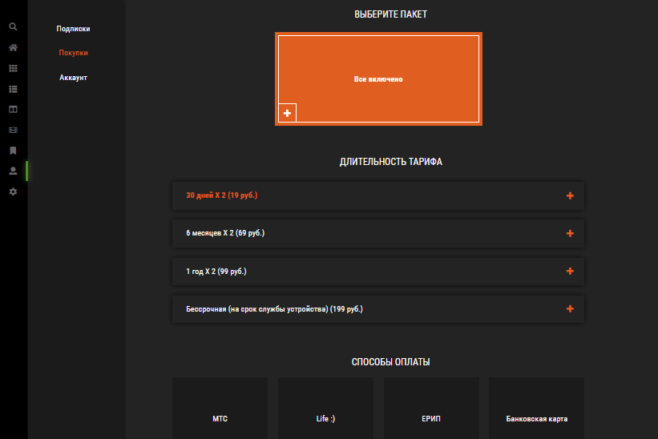
Menu & function description
User`s Cabinet > Purchases (Покупки)
❶
❷
№ | Element | Attribute
1 | Main Menu | It opens when you on the remote control press the "Return" button or the "Left" button, if any item of the “User`s Cabinet” menu is selected (The list of menu items may vary depending on whether the user is authorized or not)
2 | User`s Cabinet Menu | Activated immediately after entering User`s Cabinet or by pressing the button on the remote to the “Left” if the leftmost item is selected
3 | List of Available Subscriptions | To move the cursor from the menu to the list, use the “Right" button on the remote
4 | List of Availability Periods for the Selected Subscription | Appears after selecting a subscription
5 | List of Available Payment Methods | Appears after selecting a Availability Period for the Selected Subscription The list shows only the methods available in the user's region and available for the selected subscription
❸
❹
❺

Slide 25
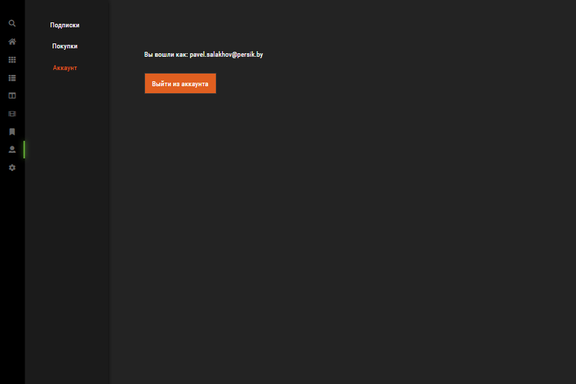
Menu & function description
User`s Cabinet > User`s Account (Аккаунт)
❶
❷
№ | Element | Attribute
1 | Main Menu | It opens when you on the remote control press the "Return" button or the "Left" button, if any item of the “User`s Cabinet” menu is selected (The list of menu items may vary depending on whether the user is authorized or not)
2 | User`s Cabinet Menu | Activated immediately after entering User`s Cabinet or by pressing the button on the remote to the “Left” if the “Logout” button is selected
3 | User Account Name
4 | Logout Button | When pressed, a PIN code request occurs, if the input is successful, the app exits the account and is redirected to the main screen
❸
❹

Slide 26
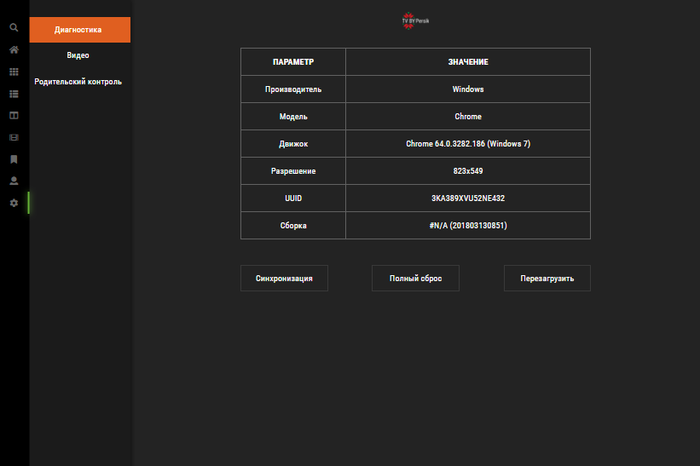
Menu & function description
Settings > Diagnostics (Диагностика)
❶
❷
№ | Element | Attribute
1 | Main Menu | It opens when you on the remote control press the "Return" button or the "Left" button, if any item of the “User`s Cabinet” menu is selected (The list of menu items may vary depending on whether the user is authorized or not)
2 | Settings Menu | Activated immediately after entering User`s Cabinet or by pressing the button on the remote to the “Left” if the “Logout” button is selected (The list of menu items may vary depending on whether the user is authorized or not)
3 | Diagnostic Information Table
4 | Sync Button | Update App Cache
5 | Full Reset Button | Reload App Cache
6 | Restart App Button
❸
❹
❺
❻

Slide 27
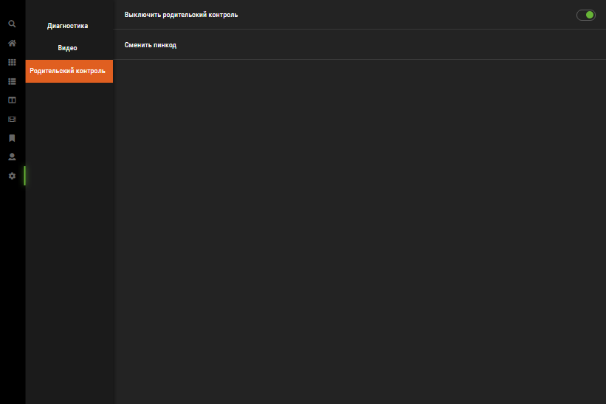
Menu & function description
Settings > Parental Control (Родительский контроль)
❶
❷
❸
№ | Element | Attribute
1 | Main Menu | It opens when you on the remote control press the "Return" button or the "Left" button, if any item of the “User`s Cabinet” menu is selected (The list of menu items may vary depending on whether the user is authorized or not)
2 | Settings Menu | Activated immediately after entering User`s Cabinet or by pressing the button on the remote to the “Left” if the “Parental Control ” menu is selected (The list of menu items may vary depending on whether the user is authorized or not)
3 | Enable/Disable Parental Control | Enable/Disable the PIN code request when logging out of the account, viewing adult content, disabling parental control, synchronization and full reset
4 | Change PIN Code | Allows you to change the pin code Default Code “0000”
❹

Slide 28
Menu & function description
Authorization
❶
№ | Element | Attribute
1 | Main Menu | It opens when you on the remote control press the "Return" button (The list of menu items may vary depending on whether the user is authorized or not)
2 | Email Field
3 | Virtual Keyboard
4 | Next Button | If the entered Email is registered, it goes to the Password Input screen, otherwise it goes to the Password Creation screen to register the entered account
❷
❸
❹

Slide 29
Menu & function description
Authorization > Password Input
❶
№ | Element | Attribute
1 | Main Menu | It opens when you on the remote control press the "Return" button (The list of menu items may vary depending on whether the user is authorized or not)
2 | User Name
3 | Password Field
4 | Virtual Keyboard
5 | Back Button | Returns to the Email input page
6 | LogIn Button | If the entered password is correct, the user will be authorized and redirected to the Main Screen
❷
❸
❹
❺
❻

Slide 30
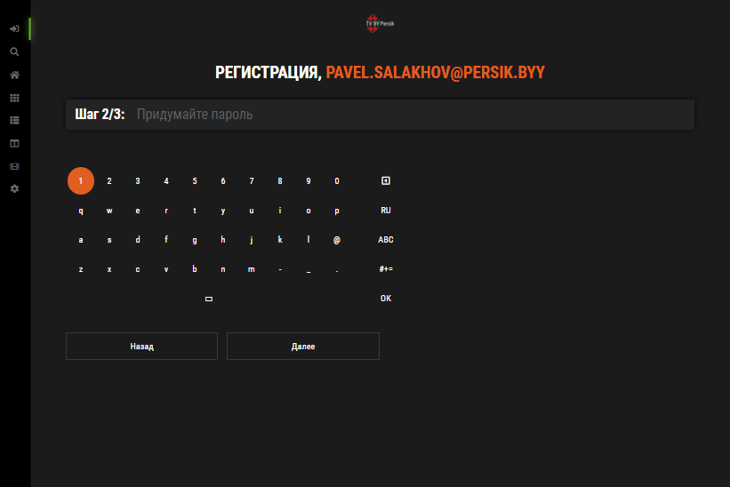
Menu & function description
Registration > Password Creation
❶
№ | Element | Attribute
1 | Main Menu | It opens when you on the remote control press the "Return" button (The list of menu items may vary depending on whether the user is authorized or not)
2 | User Name
3 | Password Field
4 | Virtual Keyboard
5 | Back Button | Returns to the Email input page
6 | Next Button | If the entered password is longer than 6 characters, the user will be redirected to the Password Confirmation screen
❷
❸
❹
❺
❻

Slide 31
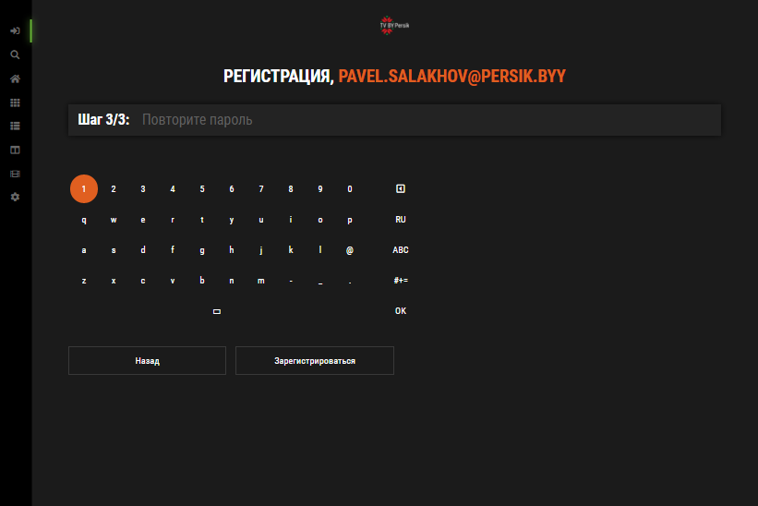
Menu & function description
Registration > Password Confirmation
❶
№ | Element | Attribute
1 | Main Menu | It opens when you on the remote control press the "Return" button (The list of menu items may vary depending on whether the user is authorized or not)
2 | User Name
3 | Password Field
4 | Virtual Keyboard
5 | Back Button | Returns to the Email input page
6 | Register Button | If the entered password is correct, the user will be Registered, Authorized and redirected to the Main Screen
❷
❸
❹
❺
❻

Slide 32
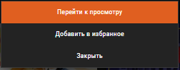
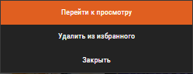
Menu & function description
TV Channel Box Context Menu
№ | Element | Attribute
1 | Go to View | It opens selected channel in TV player
2 | Add / Remove from Favorites | Adding or removing selected TV channel in favorites (Available if the user is authorized)
3 | Close | Closes this menu
❶
❷
❸

Slide 33
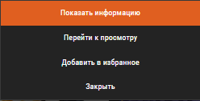

Menu & function description
VOD Box Context Menu
№ | Element | Attribute
1 | Show info | It opens selected VOD info
2 | Go to View | It opens selected VOD in player
3 | Add / Remove from Favorites | Adding or removing selected TV channel in favorites (Available if the user is authorized)
4 | Close | Closes this menu
❶
❷
❸
❹

Slide 34

Menu & function description
PIN Code Request
№ | Element | Attribute
1 | PIN Code Field
2 | Virtual Keyboard
3 | OK Button | If the PIN code is correct, the requested operation will be executed
4 | Cancel Button | Closes this request
❶
❷
❸
❹

Slide 35
Key Policy - sample
If you have your own key policy on your app, please describe it.
Button | Action | Remarks
ENTER | Interact with highlight element (if possible)
LONG PRESS ENTER | Open menu with some options (if possible)
UP/DOWN | Move highlight to up or down
LEFT/RIGHT | Move highlight to left or right
RETURN | Move to previous page | Samsung Mandatory
EXIT | Close the app and show broadcasting channel | Samsung Mandatory

Slide 36
How to change languages
Items | Contents
How to change languages | If multi languages are supported, describe how to check multi languages on the App. If not, ignore this box. (e.g.) change country setting to Spain on SMART HUB (e.g.) change OSD Language setting to German etc..

